Slide 1


Mastering Multi-Model Projects in Java
Explore the power of combining multiple data models and programming paradigms to create flexible, scalable, and high-performance applications. This presentation will guide you through the essentials of multi-model projects, their benefits, and best practices for implementation.
by Sathish V

Slide 2
What is a Multi-Model Project?
Definition
Use Cases
A project using multiple data models or programming paradigms to achieve different goals within the same system.
Combining SQL and NoSQL databases
Using both monolithic and microservices architectures

Slide 3




Key Characteristics of Multi-Model Projects
Multiple Data Models
SQL, NoSQL, Graph databases coexisting in one project.
Various Architectures
Monolithic, microservices, and serverless working together.
Interoperability
Seamless interaction between different models and technologies.

Slide 4




Benefits of Multi-Model Projects
Flexibility
1
Choose the best model for each system component.
Scalability
2
Scale different parts independently, like with microservices.
Performance
3
Optimize read/write operations, consistency, and fault tolerance.
Adaptability
4
Integrate new models without disrupting existing ones.

Slide 5
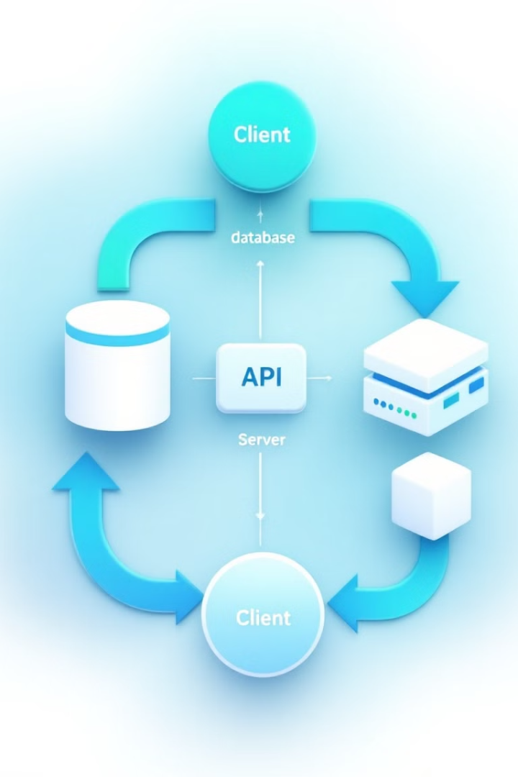



Architectural Considerations
Data Consistency
Manage consistency between SQL and NoSQL databases using CQRS or eventual consistency.
Inter-Service Communication
Use RESTful APIs, GraphQL, or message queues for data synchronization.
API Gateway
Implement a unified API layer to aggregate responses from multiple models.

Slide 6




Tools & Technologies for Java Multi-Model Projects
These tools enable building microservices, handling data streams, containerization, and providing unified API layers in multi-model Java projects.

Slide 7

Best Practices & Conclusion
Use the Right Tool for the Job
Decouple Services
Keep microservices independent for better scalability and maintainability.
Select databases and architectures best suited for specific needs.
Monitor and Test
Implement robust testing and monitor system health and performance.

